Slide 1
Software engineering Agile process model
Dr.Sachin Bojewar

Slide 2
Agile Methodology
Agile means ‘ability to move quickly and easily’ and responding swiftly to change
In traditional software development methodologies like Waterfall model, a project can take several months or years to complete and the customer may not get to see the end product until the completion of the project.
In contrast to this, Agile projects have Sprints or iterations which are shorter in duration (from 2 weeks to 2 months) during which pre-determined features are developed and delivered.

Slide 3
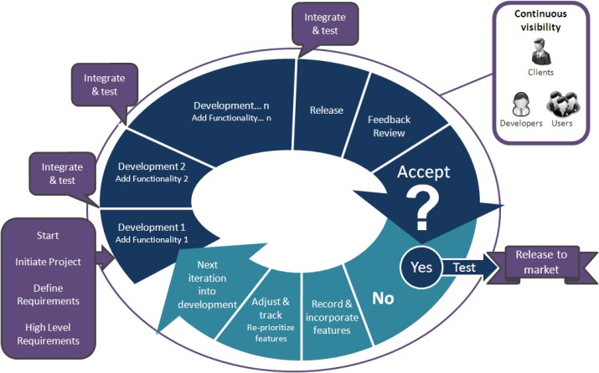

Slide 4
Agile Development methodology
In the Agile methodology, each project is broken up into several ‘Iterations’.
All Iterations should be of the same time duration (between 2 to 8 weeks).
At the end of each iteration, a working product should be delivered.
In simple terms, in the Agile approach the project will be broken up into n releases (assuming each iteration is set to last 4 weeks).
Rather than spending 1.5 months on requirements gathering, in Agile software development, the team will decide the basic core features that are required in the product and decide which of these features can be developed in the first iteration.

Slide 5
Agile Development methodology
Any remaining features that cannot be delivered in the first iteration will be taken up in the next iteration or subsequent iterations, based on priority.
At the end of the first iterations, the team will deliver a working software with the features that were finalized for that iteration.
There will be n iterations and at the end of each iteration the customer is delivered a working software that is incrementally enhanced and updated with the features that were shortlisted for that iteration.

Slide 6
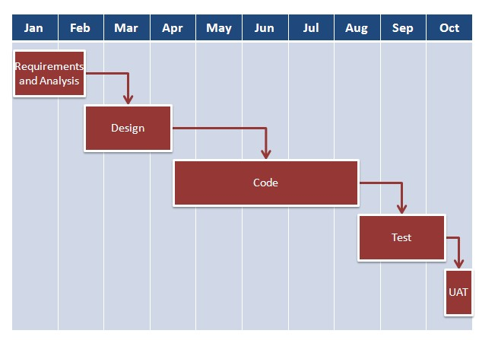
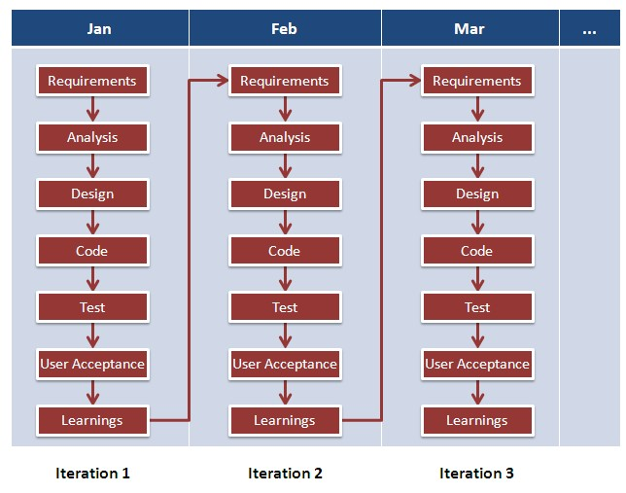
Traditional S/W Development
Agile S/W Development

Slide 7
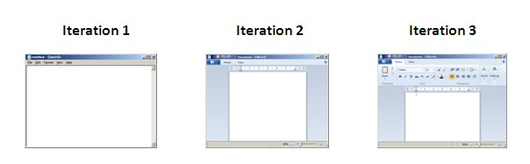
Agile development – example

Slide 8
Agile Principles
Highest priority is to satisfy the customer through early and continuous delivery of valuable software.
Welcome changing requirements, even late in development. Agile processes harness change for the customer’s competitive advantage.
Deliver working software frequently, from a couple of weeks to a couple of months, with a preference to the shorter timescale.
Business people and developers must work together daily throughout the project.
Build projects around motivated individuals. Give them the environment and support they need, and trust them to get the job done.
The most efficient and effective method of conveying information to and within a development team is face-to-face conversation.

Slide 9
Agile Principles
Working software is the primary measure of progress.
Agile processes promote sustainable development. The sponsors, developers, and users should be able to maintain a constant pace indefinitely.
Continuous attention to technical excellence and good design enhances agility.
Simplicity—the art of maximizing the amount of work not done—is essential.
The best architectures, requirements, and designs emerge from self organizing teams.
At regular intervals, the team reflects on how to become more effective, then tunes and adjusts its behaviour accordingly.

Slide 10
Agile Software Development
Agile Process and Process Models,
XP
Adaptive And Dynamic System Development-[ASD, DSDM],
SCRUM,
FEATURE DRIVEN DEVELOPMENT

Slide 11
Extreme Programming (XP)
The most widely used agile process, originally proposed by Kent Beck
XP uses an object oriented approach
XP encompasses a set of rules and practices that occur within the context of four framework activities
Planning
Design
Coding
Test

Slide 12
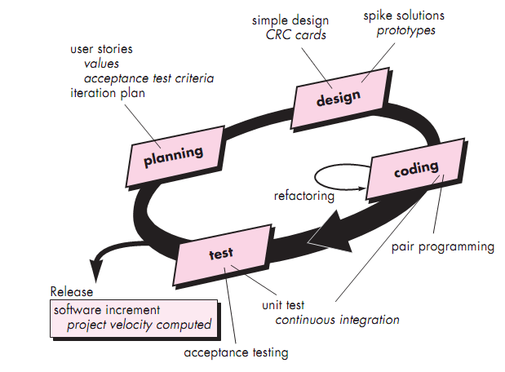

Slide 13
XP Planning
Begins with the creation of set of stories called as
“user stories “ that describe required features and functionality for s/w development
Each story is written by the customer and is placed on an index card. The customer assigns a value (i.e., a priority) to the story based on the overall business value of the feature or function
then Agile team assesses each story and assigns a cost
If the story is estimated to require more than three development weeks, the customer is asked to split the story into smaller stories and the assignment of value and cost occurs again.
It is important to note that new stories can be written at any time.
Stories are grouped to for a deliverable increment

Slide 14
XP Planning
A commitment is made on delivery date
After the first increment “project velocity” is used to define subsequent delivery dates for other increments
project velocity is the number of customer stories implemented during the first release.
As development work proceeds, the customer can add stories, change the value of an existing story, split stories, or eliminate them.
The XP team then reconsiders all remaining releases and modifies its plans accordingly.

Slide 15
XP Design
Follows the KIS (keep it simple) principle
A simple design is always preferred over a more complex representation.
Encourage the use of CRC cards
CRC (class-responsibility collaborator) cards identify and organize the object-oriented classes that are relevant to the current software increment.

Slide 16
XP Design
For difficult design problems, suggests the creation of “spike solutions”—a design prototype
If a difficult design problem is encountered, then XP recommends the immediate creation of an operational prototype of that portion of the design called a spike solution

Slide 17
XP Coding
Recommends the construction of a unit test for a story.
Key concept during coding activity is “pair programming”
XP recommends that two people work together at one computer workstation to create code for a story.
This provides a mechanism for real-time problem solving (two heads are often better than one) and real-time quality assurance.

Slide 18
XP Testing
All unit tests are executed daily
The unit tests that are created should be implemented using a framework that enables them to be automated
“Acceptance tests” are defined by the customer and implemented to assess visible functionality
Acceptance tests are derived from user stories that have been implemented as part of a software release.

Slide 19
XP coding
Encourages “refactoring”—an iterative refinement of the internal program design
Refactoring is the process of changing a software system in such a way that it does not alter the external behavior of the code yet improves the internal structure.

Slide 20
ASD - Adaptive Software Development
There are mainly 3 activities in ASD
Speculation
Collaboration
learning

Slide 21
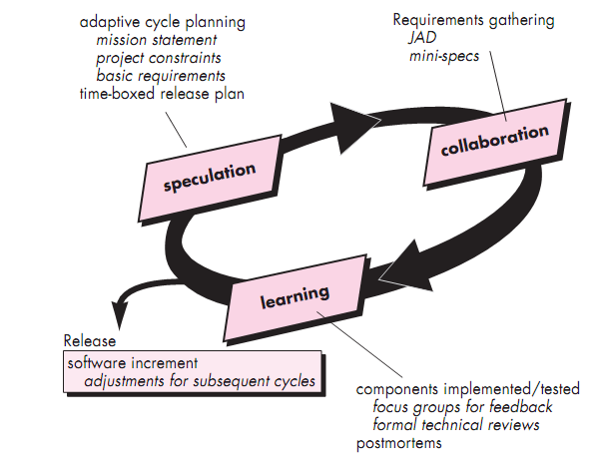

Slide 22
ASD-speculation
The project is initiated and adaptive cycle planning is conducted.
Adaptive cycle planning uses
project initiation information
the customer’s mission statement,
project constraints etc to define the set of release cycles (software increments) that will be required for the project.
Based on information obtained at the completion of the first cycle, the plan is reviewed and adjusted so that planned work better fits the reality in which an ASD team is working.

Slide 23
ASD- Collaboration
It encompasses communication and teamwork, but it also emphasizes individuality, because individual creativity plays an important role in collaborative thinking.
People working together must trust one another
work as hard as or harder than they do
have the skill set to contribute to the work at hand, and
communicate problems or concerns in a way that leads to effective action.

Slide 24
ASD-Learning
learning will help them to improve their level of real understanding.
ASD teams learn in three ways:
focus groups – client feedback
Formal technical reviews – review S/W components
project postmortems –improve Quality development

Slide 25
SCRUM
Scrum principles are consistent with the agile platform and are used to guide development activities within a process that incorporates the following framework activities:
requirements,
analysis,
design,
evolution,
delivery.

Slide 26
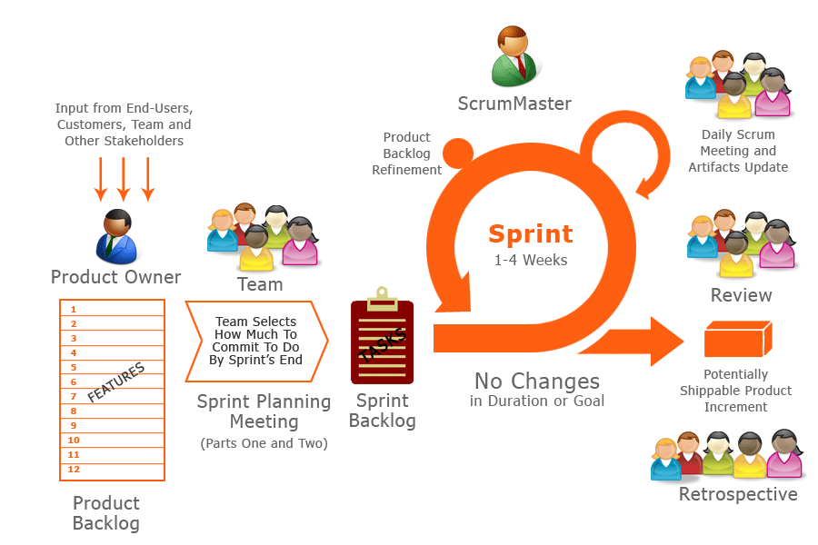

Slide 27
Within each framework activity work tasks occur within a process pattern called a sprint.
Scrum emphasizes the use of a set of software process patterns that have proven effective for projects with tight timelines, changing requirements, and business criticality.
Each of these process patterns defines a set of development actions:
Backlog—a prioritized list of project requirements or features that provide business value for the customer.
Items can be added to the backlog at any time
The product manager assesses the backlog and updates priorities as required.

Slide 28
Sprints—consist of work units that are required to achieve a requirement defined in the backlog that must be fit into a predefined time-box (typically 30 days)
Changes are not introduced during the sprint.
Hence, the sprint allows team members to work in a short-term, but stable environment.

Slide 29
Scrum meetings—are short (typically 15 minutes) meetings held daily by the Scrum team.
Three key questions are asked and answered by all team members:
What did you do since the last team meeting?
i.e Last meeting till now.
What difficulties are you encountering?
What is your plan to accomplish by the next team meeting?

Slide 30
A team leader, called a Scrum master, leads the meeting and assesses the responses from each person.
The Scrum meeting helps the team to uncover potential problems as early as possible.
Also, these daily meetings lead to “knowledge socialization” and thereby promote a self-organizing team structure.

Slide 31
Demos—deliver the software increment to the customer so that functionality that has been implemented can be demonstrated and evaluated by the customer.
It is important to note that the demo may not contain all planned functionality, but rather those functions that can be delivered within the time-box that was established.
Scrum process patterns enable a software team to work successfully in a world where the elimination of uncertainty is impossible.

Slide 32
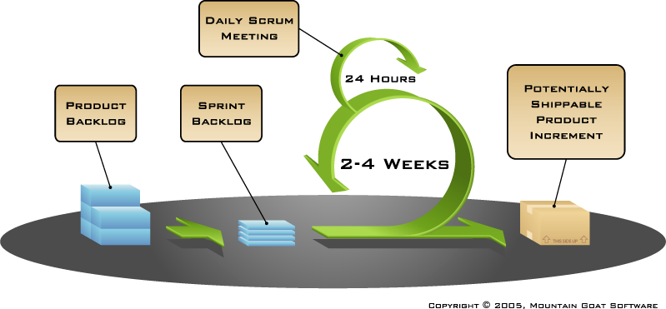
DEMO

Slide 33
Dynamic Systems Development Method (DSDM)
It is an agile software development approach that “provides a framework for building and maintaining systems which meet tight time constraints through the use of incremental prototyping in a controlled project environment”
DSDM is an iterative software process in which each iteration follows the 80 percent rule.
That is, only enough work is required for each increment to assist movement to the next increment.
The remaining detail can be completed later when more business requirements are known or changes have been requested and accommodated.

Slide 34
The DSDM consortium has defined an agile process model, called the DSDM life cycle that defines three different iterative cycles, preceded by two additional life cycle activities:
Feasibility study—establishes the basic business requirements and constraints associated with the application to be built and then assesses whether the application is a viable candidate for the DSDM process.

Slide 35
Business study—establishes the functional and information requirements that will allow the application to provide business value; also, defines the basic application architecture and identifies the maintainability requirements for the application.
Functional model iteration—produces a set of incremental prototypes that demonstrate functionality for the Customer.
The intent during this iterative cycle is to gather additional requirements by eliciting Feedback from users as they use the prototype.

Slide 36
Design and build iteration—revisits prototypes built during functional model iteration to ensure that each has been engineered in a manner that will enable it to provide operational business value for end users.
In some cases, functional model iteration and design and build iteration occur concurrently.

Slide 37
Implementation—places the latest software increment into the operational environment.
It should be noted that
(1) the increment may not be 100 percent complete or
(2) changes may be requested as the increment is put into place.
In either case, DSDM development work continues by returning to the functional model iteration activity.

Slide 38
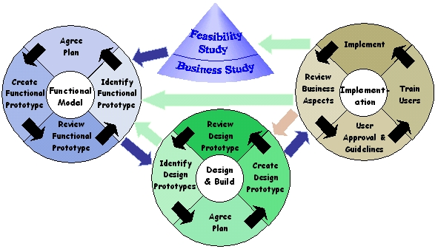

Slide 39
The project flow may move between the different phases in the directions indicated by the arrows above. The dark blue arrows in the diagram indicate the normal forward direction of project flow. The green arrows indicate directions that may be taken as necessary under normal circumstances.
The light red arrow represents a direction that is only taken if the project has been found to not meet the required functionality.

Slide 40
FDD-Feature Driven Development
FDD adopts a philosophy that
Emphasizes collaboration among people on an FDD team;
(2) Manages problem and project complexity using feature-based decomposition followed by the integration of software increments, and
(3) Communication Of Technical Detail Using Verbal, Graphical, And Text-based Means.

Slide 41
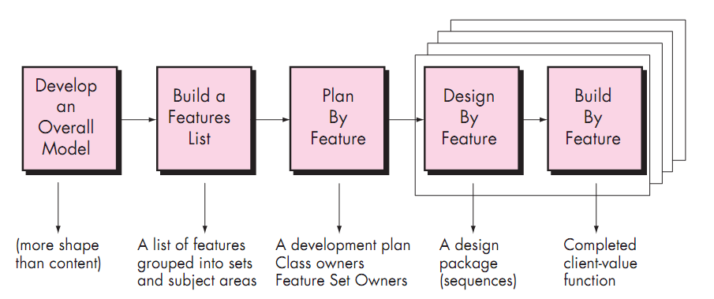
FDD

Slide 42
Develop an Overall Model: building a mainly structural model of the problem domain called the Object Model.
Build a Features List: identifying the required functionality of the system, expressed as features and feature sets.
Plan by Feature: scheduling the features for development, and assigning the feature sets (activities) and the classes in and assigning the feature sets (activities), and the classes in the object model, to developers.

Slide 43
Design by Feature: determining how the features should be realized at run-time by interactions among objects.
Build by Feature: coding and unit-testing the necessary items for realization of the features. Implemented items are then for realization of the features. Implemented items are then promoted to the main build.

